Slide 1
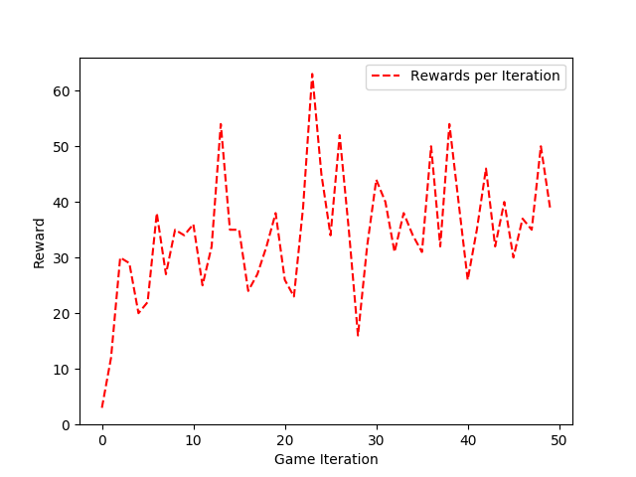
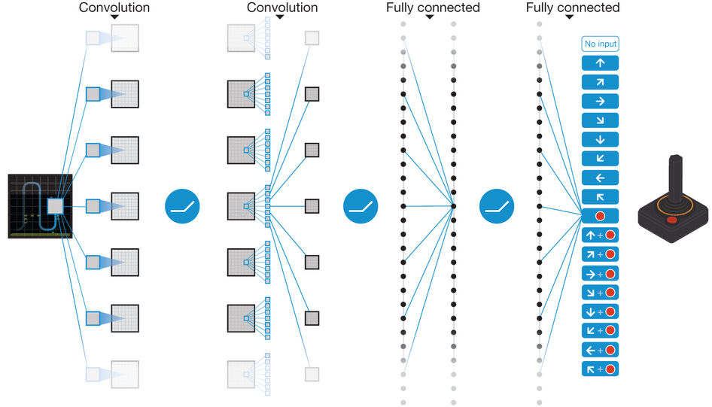
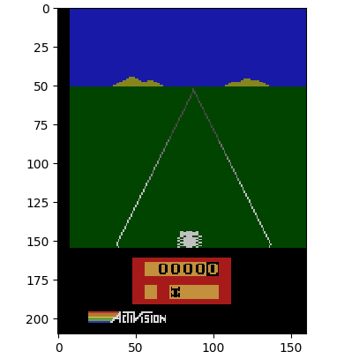
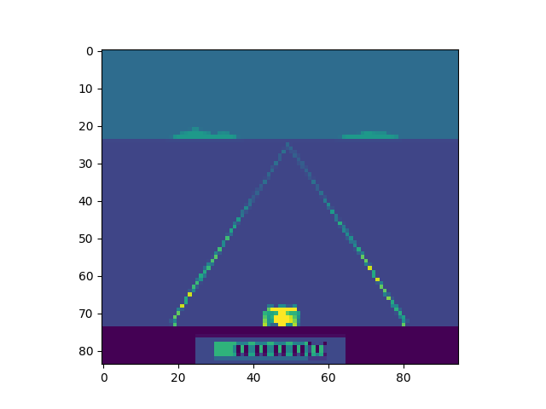
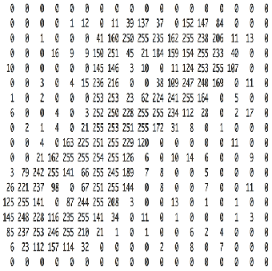
Building an Artificially Intelligent Machine
Using Atari 2600 to Emphasize the Viability of Reinforcement Learning
An Integrated Research Component by Nathan Metze
Being Presented on Tuesday, November 14th 2017 at 5:30
Abstract: Within the field of machine learning, there exists a subfield known as reinforcement learning. In this paper, a Deep Q-learner model, a type of reinforcement learning, is selected to interpret high-dimensional sensory input with the goal of returning a value function that estimates future rewards, or actions to take. For this paper, a deep Q-learner model, or agent, is self-taught how to play an Atari 2600 video game, Enduro. This understanding of the game can be derived by the agent’s ability to repeatedly perform positive actions over a given amount of time. This paper helps emphasize the viability of reinforcement learning using deep Q-learning in test environments such as the Atari 2600.
Training
Time Spent Training:
  10 days
Frames Processed:
  11,115,632
System Architecture:
  The agent was trained using VMware
    Operating System
      Ubuntu 17.10
      12GB Ram
      Intel I7-6700K CPU @ 4.0 GHz
    Tools Used
      OpenAI Gym
      TensorFlow
Methodology
Results
The algorithms used to train the deep Q-learner model includes both a convolutional neural network and a Q-learner. In order for the Q-learner to effectively decide an action it must compute every possible state, which in a simple instance would be 110x110x4, for four images. Thus, the convolutional neural network is used to speed up this process by mapping all the possible states to the amount of action states available in the game. This significantly improves the computational speed.
Spacer
Start
Codon
Figure 6: Q-learner algorithm used - based upon the Bellman equation
Benchmarking: The agent was evaluated by playing fifty iterations of the game while only taking an action every fourth frame. This was done to ensure the agent was on the same playing field as a human player, who can only realistically act on every fourth visible frame.
Hyperparameters:
gamma: 0.95 (reward discount rate)
epsilon: 1.00 (exploration rate)
epsilon decay: 0.99 (rate of decay)
max frames: 200,000 (frames saved)
mini batch size: 32 (sample size)
Figure 1: Convolutional Neural Network with 5 Layers used to develop the deep q-learner¹
Figure 2: Q-learner algorithm used - based upon the Bellman equation
Processing the Data
Layer | Depth | Filter | Stride | Activation
Convolution-1 | 32 | 8x8 | 4 | ReLU
Convolution-2 | 64 | 4x4 | 2 | ReLU
Convolution-3 | 64 | 3x3 | 1 | ReLU
Connected-1 | 512 | N/A | N/A | ReLU
Connected-2 | # of actions (9) | N/A | N/A | Linear
Figure 3: Preprocessed game image
Figure 4: Processed game image
The initial image is processed to remove features including red, green, blue colors as well as the black border. This makes it easier for the neural network to find important features.
Figure 7: Convolutional Neural Network Architecture
1. Mnih, Volodymyr, et al. “Human-level control through deep reinforcement learning” Nature International Journal of Science, 25 Feb. 2015, https://www.nature.com/articles/nature14236. Accessed 12 Sept. 2017.
Figure 5: Example of what a computer sees

